Slide 1
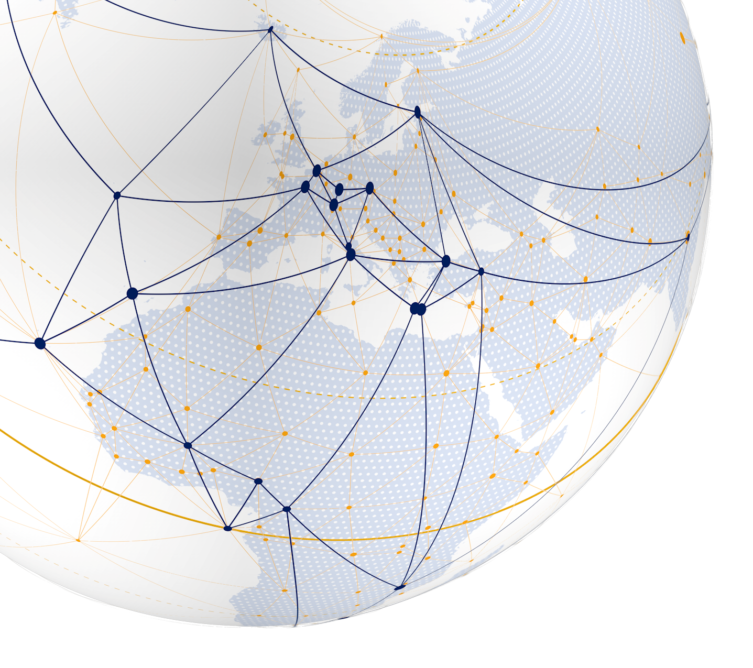
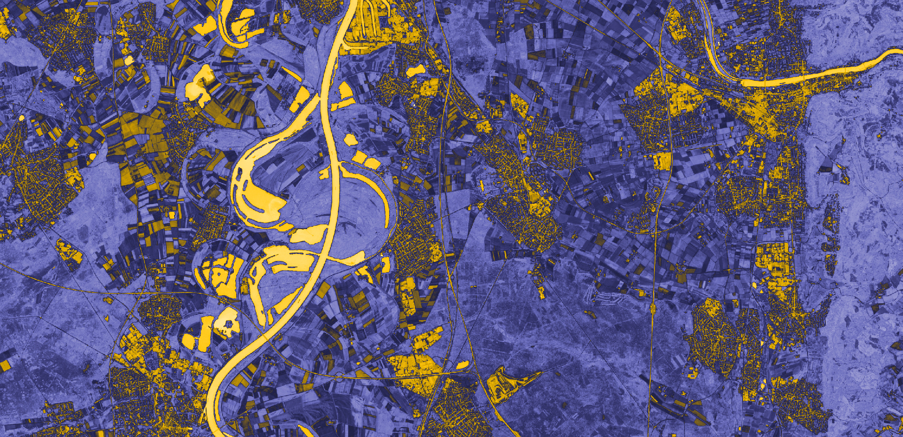
International Medical Geography Symposium (IMGS). Atlanta, 18th July 2024
Unequal Scene and Health Inequality in Rapidly
Growing City of Akure: The Nigerian Reality.
Heidelberg University and Heidelberg University of Education, Germany.
Taye BAYODE, Alexander SIEGMUND & Olumuyiwa AKINBAMIJO
Pädagogische Hochschule Heidelberg
Abteilung Geographie | Research Group for Earth Observation – ^{r}geo
www.rgeo.de

Slide 2
Outline
Introduction
Materials and Methods
Results
Research limitations
Recommendations
Unequal Scene and Health Inequality in Rapidly Growing City of Akure. I Taye Bayode
Notes:
Organigramm → wie kommt Struktur klarer raus?
Skizzieren: F-Runde, Kompetenzzentren, Projekte (didaktisch, fachlich), Stabstellen (Melly Brigitte), Geschäftsführer UNESCO und Assistenz

Slide 3
Introduction
Dept. of Geography – Research Group of Earth Observation (^{r}geo) – Taye Bayode, M.Sc.
Notes:
https://www.qoctor.com.au/malaria/

Slide 4
Introduction
2018 (219 million) global malaria cases
2019 (228 million) global malaria cases
(a) Paradox of malaria burden
Notes:
https://www.qoctor.com.au/malaria/

Slide 5
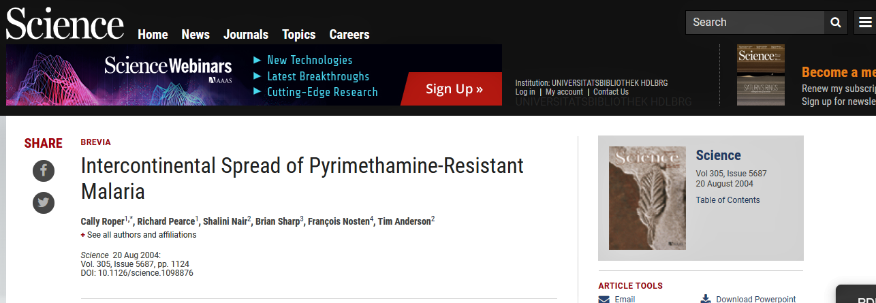
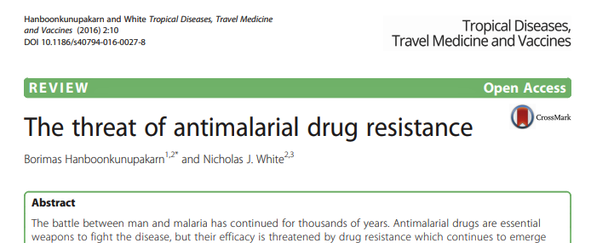
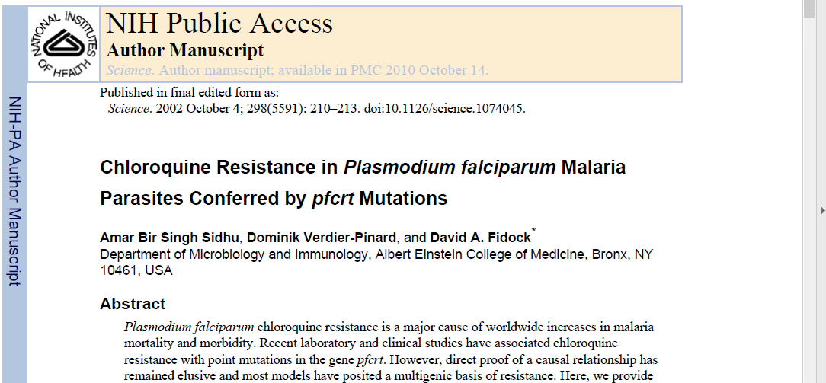
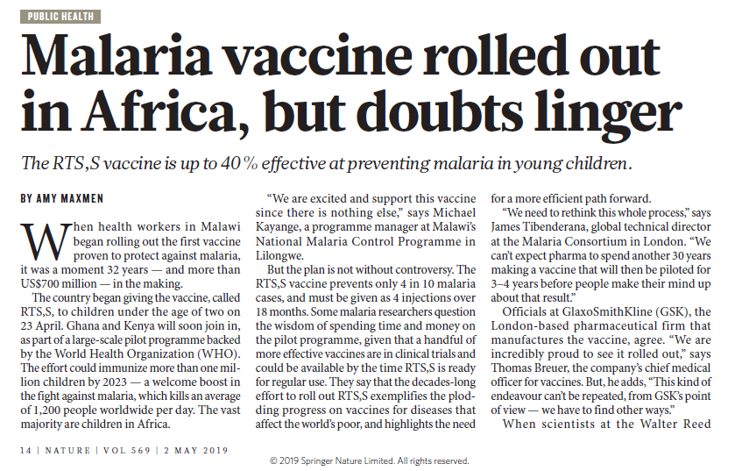
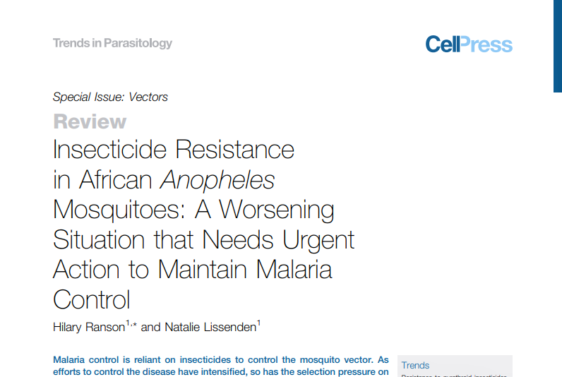
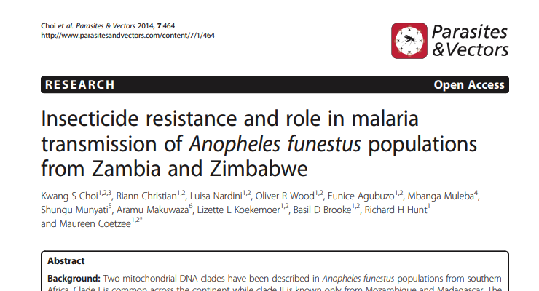
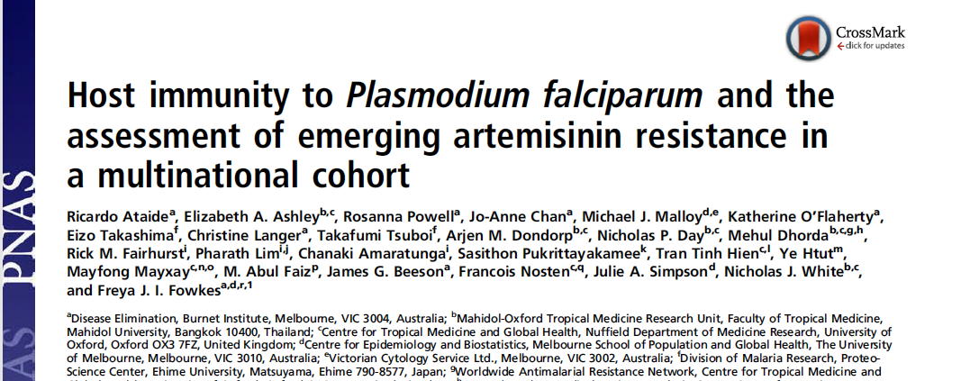
Malaria Eradication: Complexities and Difficulties
Unequal Scene and Health Inequality in Rapidly Growing City of Akure. I Taye Bayode

Slide 6
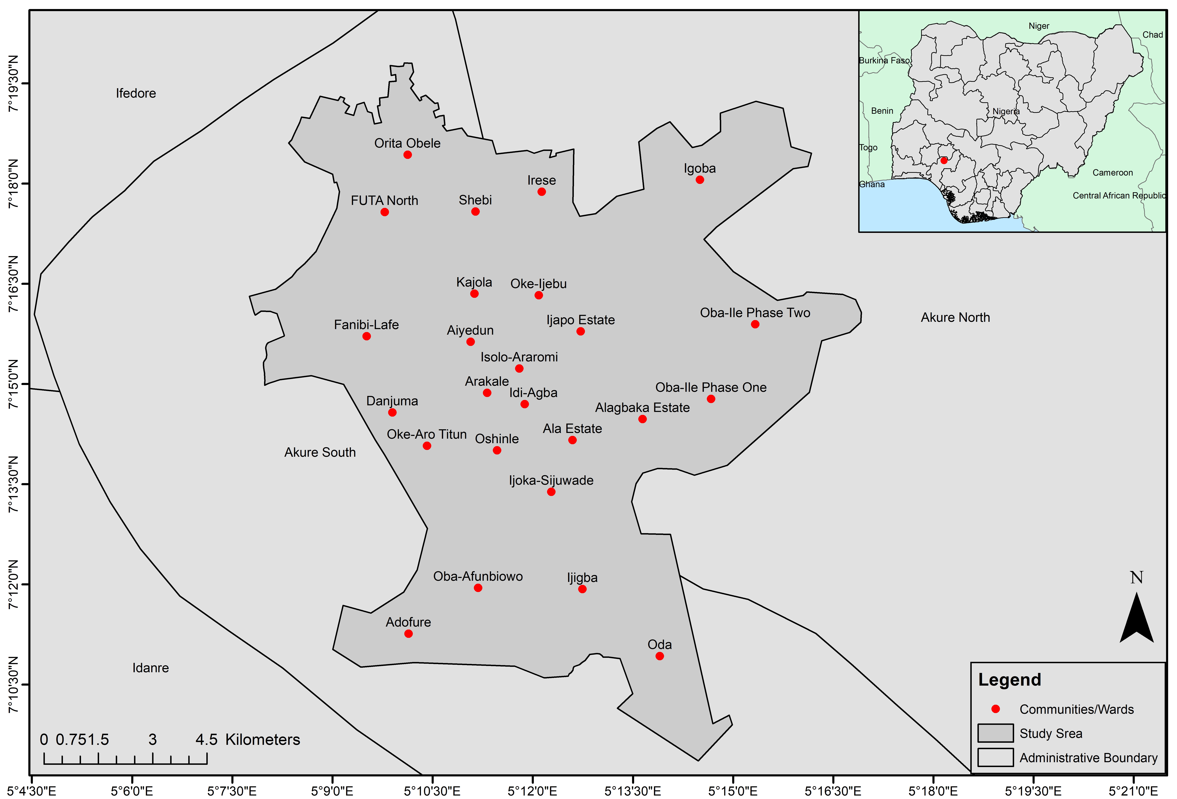
Why Akure?
Hotspot of malaria burden; >100,000 deaths since 2017; Paradoxical phenomenon
Environmental suitability for malaria vectors
Masking of local variation;
Limited health resources
Unequal Scene and Health Inequality in Rapidly Growing City of Akure. I Taye Bayode
Notes:
City level variation – Burden masking

Slide 7
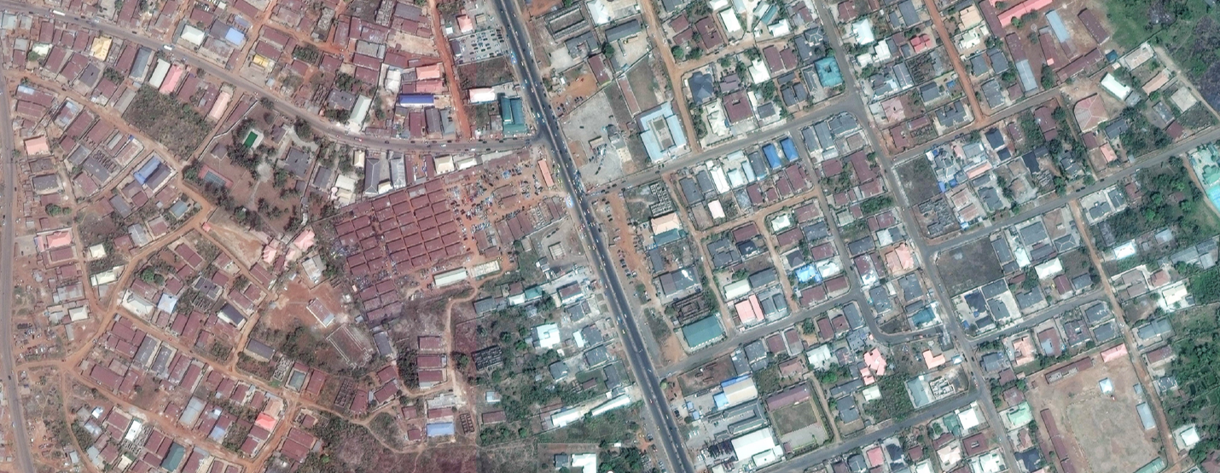
Unequal Scene
Cities have the capacity to predispose certain population to increased disease burden
Unequal Scene and Health Inequality in Rapidly Growing City of Akure. I Taye Bayode

Slide 8
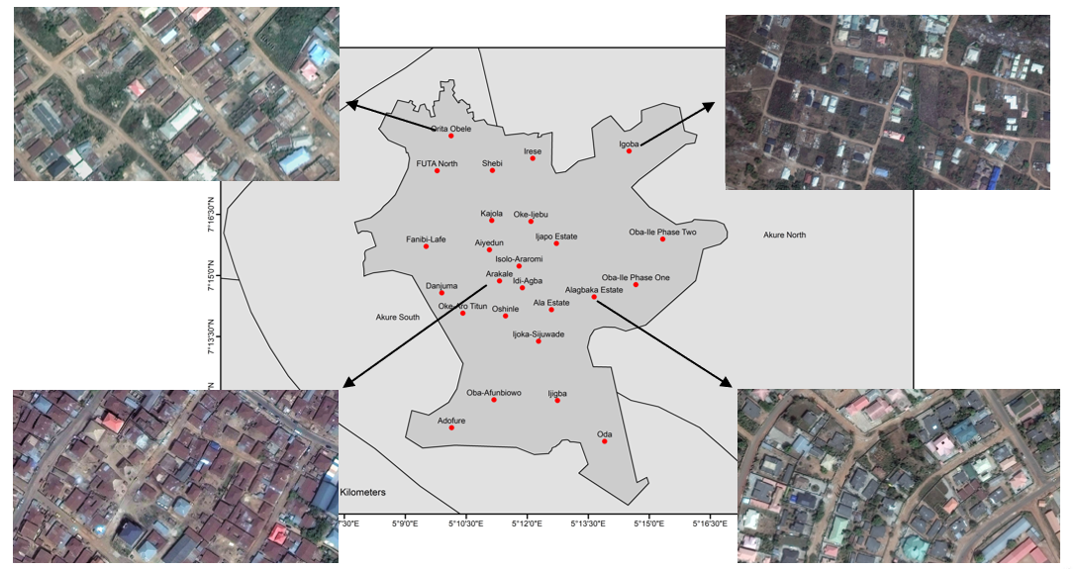
Urban Morphology – Case of Akure
Unequal Scene and Health Inequality in Rapidly Growing City of Akure. I Taye Bayode
Notes:
City level variation – Burden masking

Slide 9
Research Questions
Spatial Growth Dynamics and importance of health in urban development
Spatial Variability of U5 malaria
Relationship of urban structure to disease prevalence
Unequal Scene and Health Inequality in Rapidly Growing City of Akure. I Taye Bayode
Notes:
City level variation – Burden masking

Slide 10
Land Cover classification between 1984 and 2023.
Unequal Scene and Health Inequality in Rapidly Growing City of Akure. I Taye Bayode

Slide 11
Conventional to Contemporary Statistical Method
Bivariate analysis (χ²)
BIC
k log(n) – 2log(L(θ̂)
GLM analysis P(X) = P(Y=1|X)
Exploratory model building
Parameter estimation
Model selection
Unequal Scene and Health Inequality in Rapidly Growing City of Akure. I Taye Bayode

Slide 12
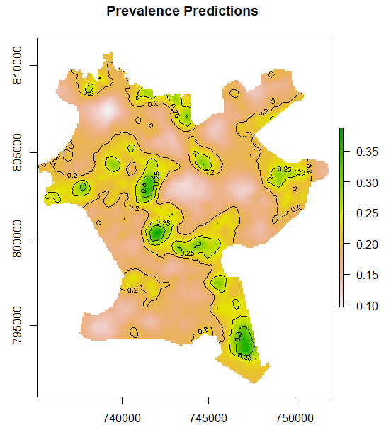
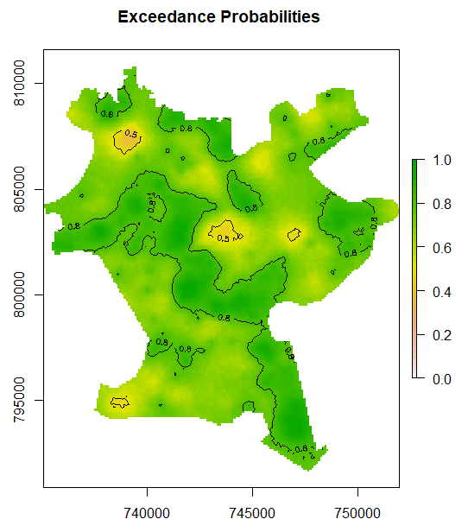
MBG Results
EP ($𝒳$) = Probability [$𝒫(𝒳)$> $𝓉$ $| Y_{1},…., Y_{N}$].
Unequal Scene and Health Inequality in Rapidly Growing City of Akure. I Taye Bayode

Slide 13
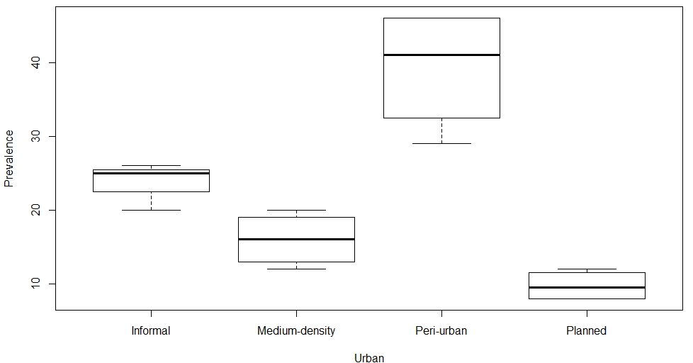
ANOVA Results
Unequal Scene and Health Inequality in Rapidly Growing City of Akure. I Taye Bayode

Slide 14
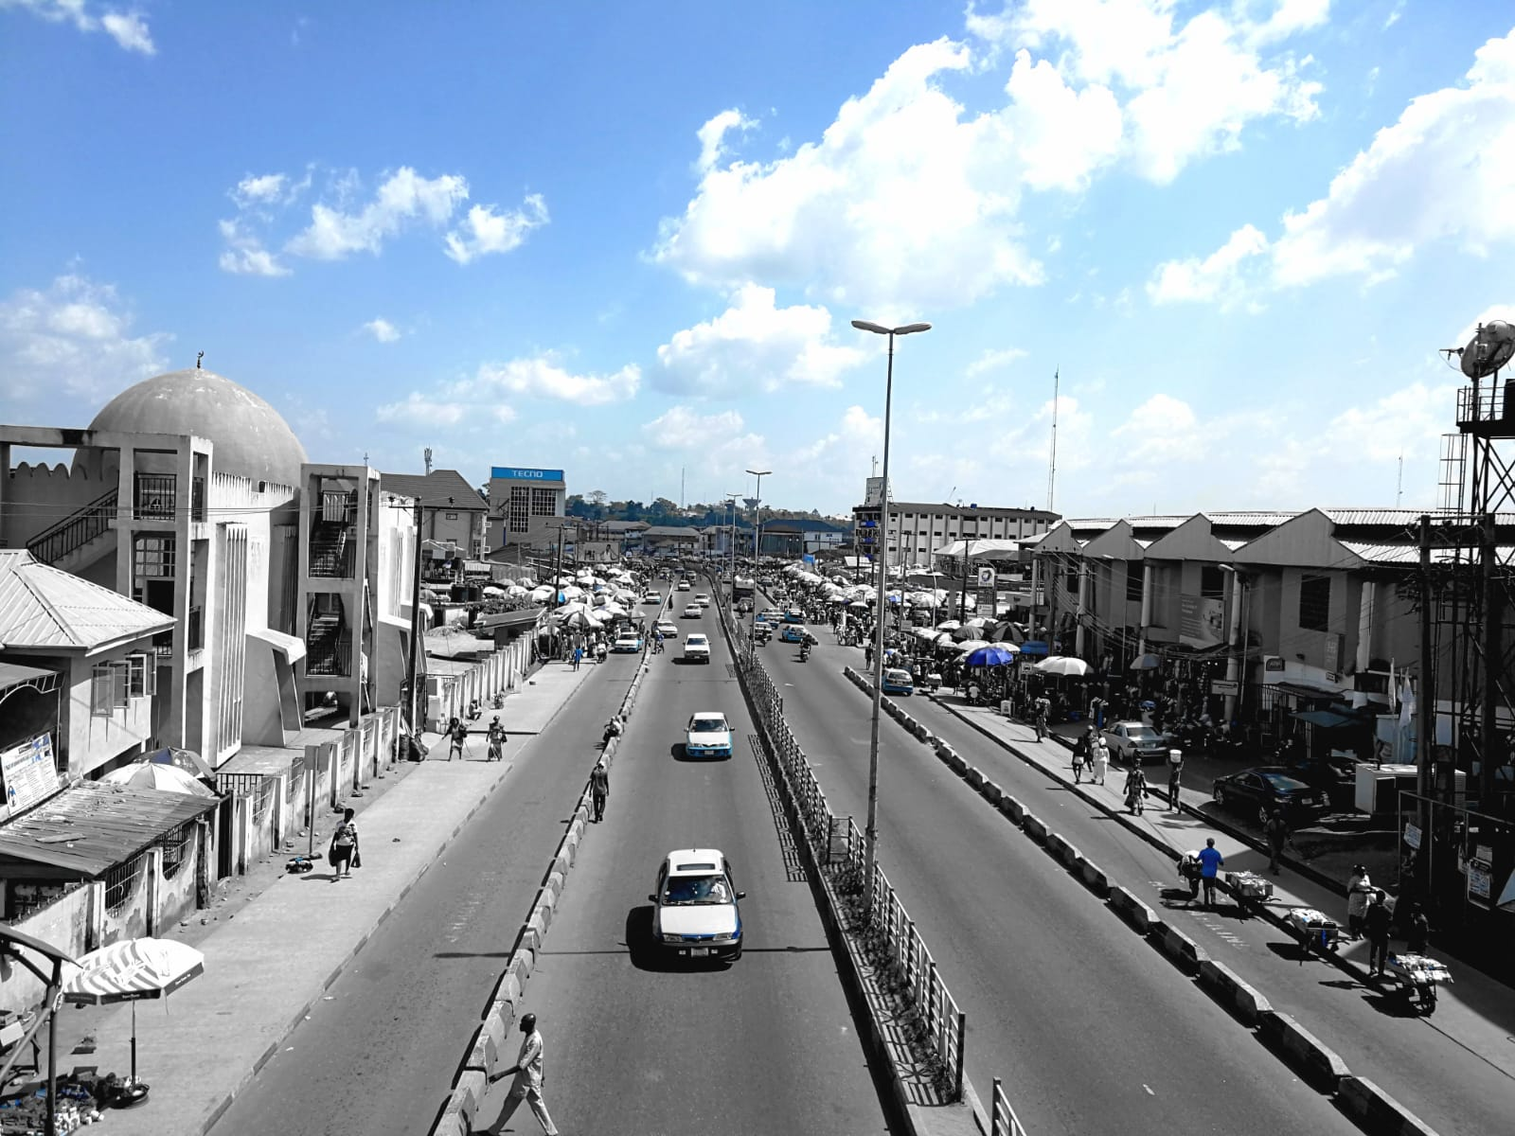
Research limitations
Cross-sectional approach
Recall bias
Place of residence
Paucity and type of data
Unequal Scene and Health Inequality in Rapidly Growing City of Akure. I Taye Bayode

Slide 15
Recommendations
The concept of sustainability should guide the inception and development of cities
Spatial planner should not be perceived as pseudo-health experts, but De-facto health professionals.
Urban development regulation to curb urban sprawl in Akure
Decentralisation of local services
Unequal Scene and Health Inequality in Rapidly Growing City of Akure. I Taye Bayode

Slide 16
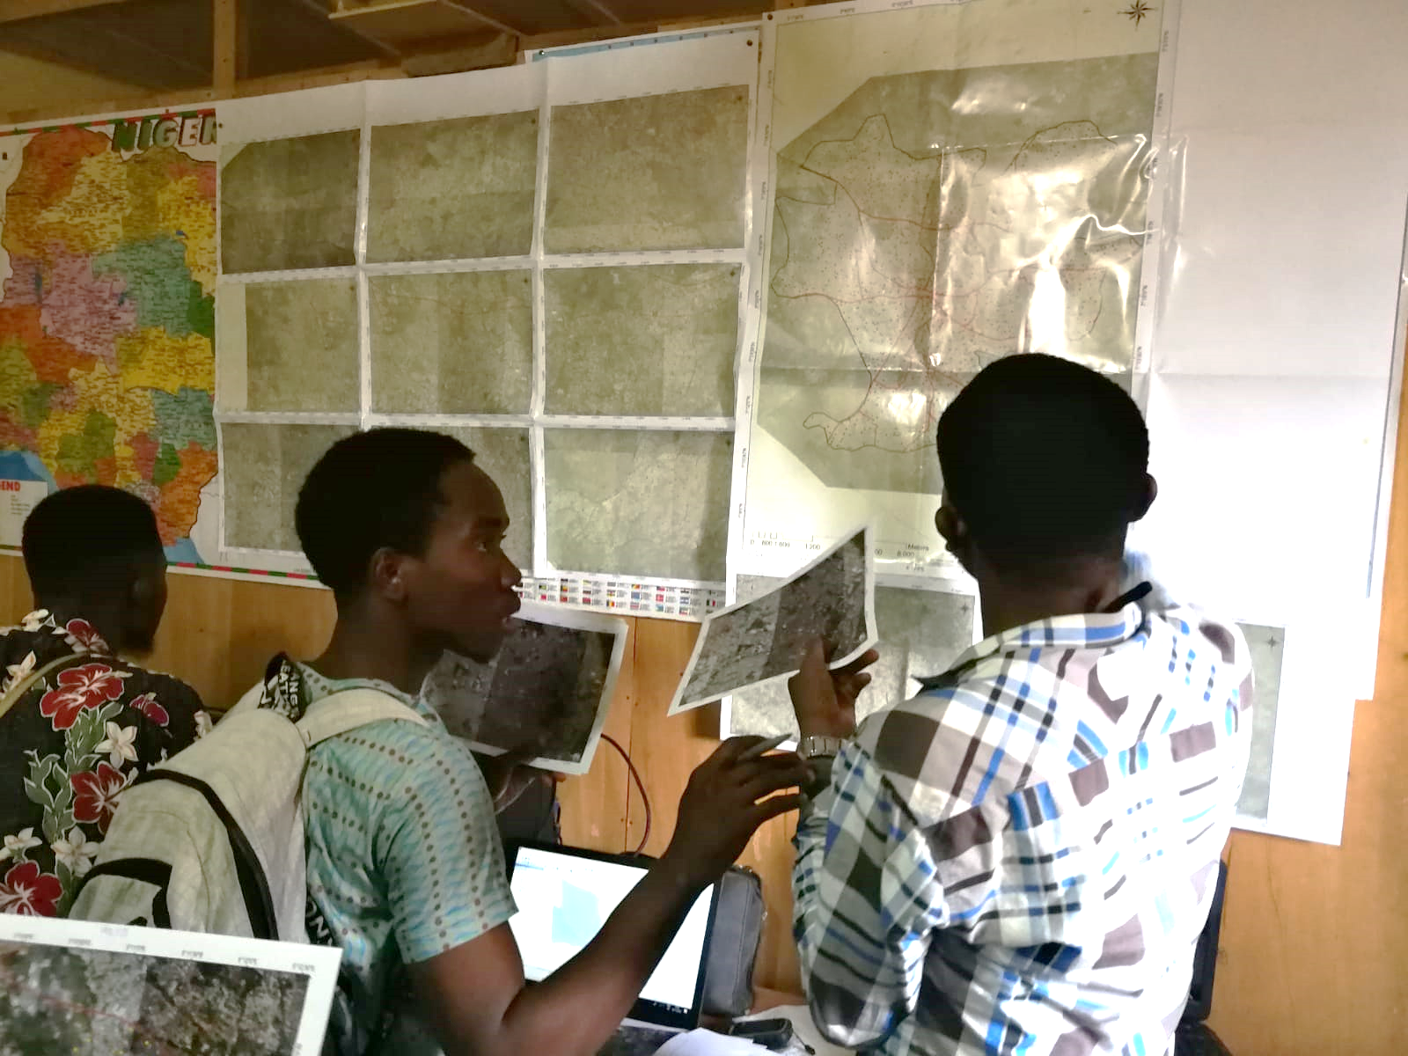
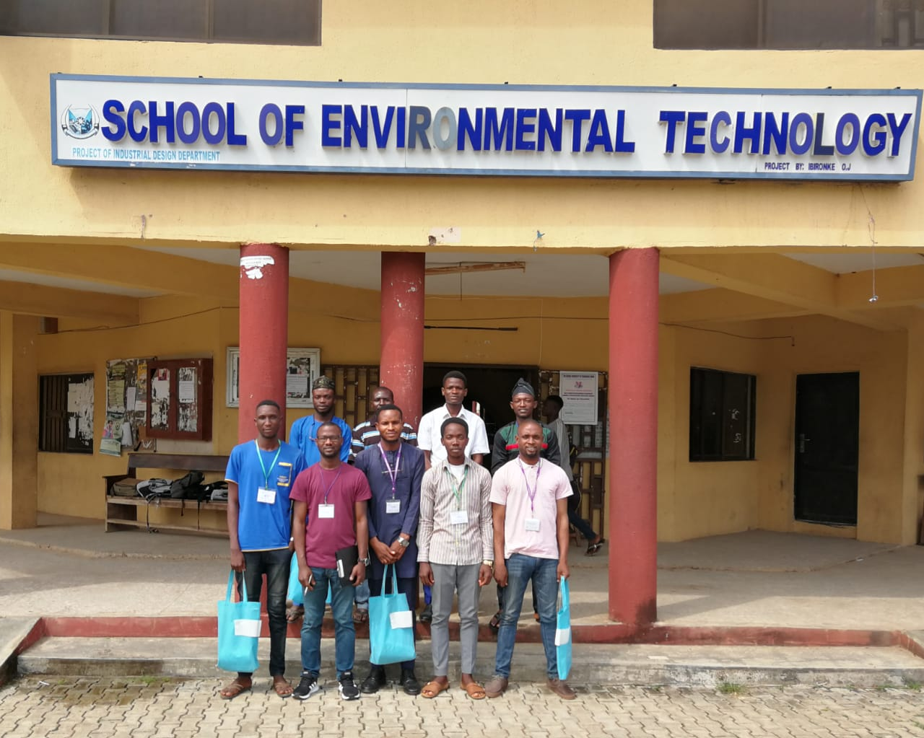
Acknowledgment
Unequal Scene and Health Inequality in Rapidly Growing City of Akure. I Taye Bayode

Slide 17
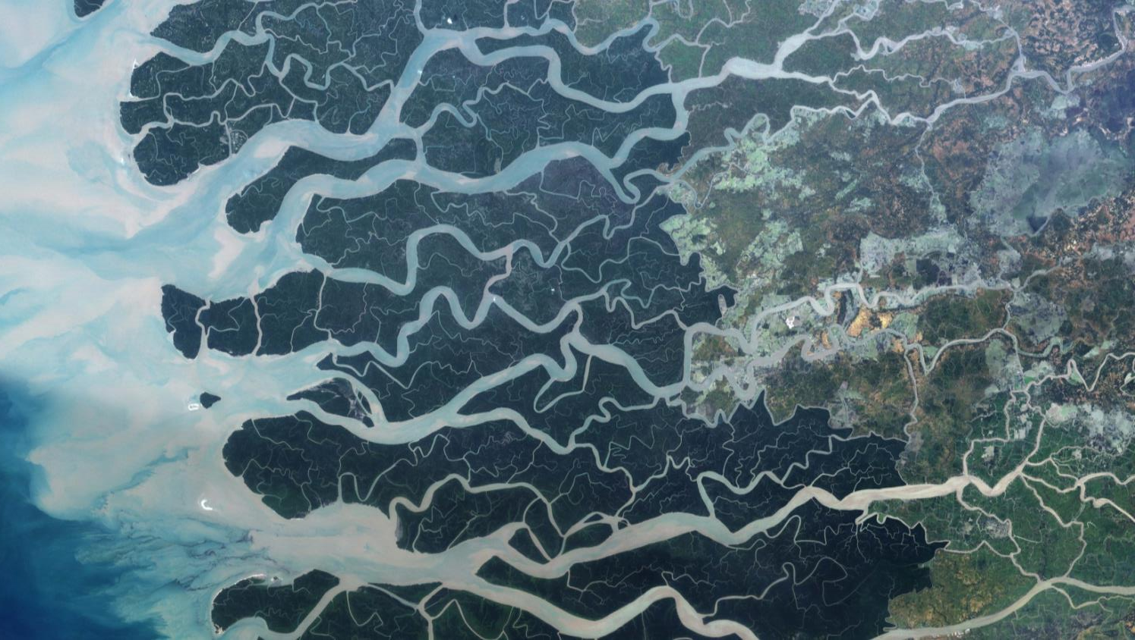
Atlanta, 18th. July, 2024

