Slide 1
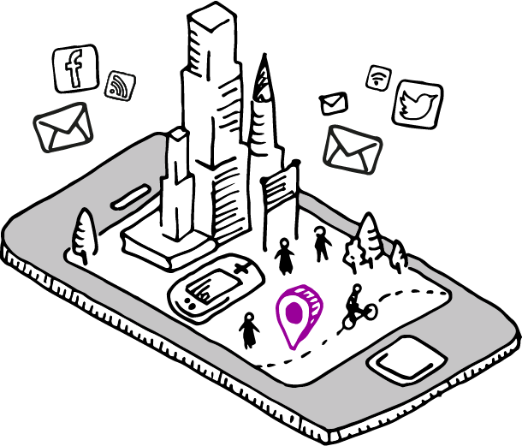
Smart Cities and Disability
Faculty For Health Sciences and Medicine

Slide 2
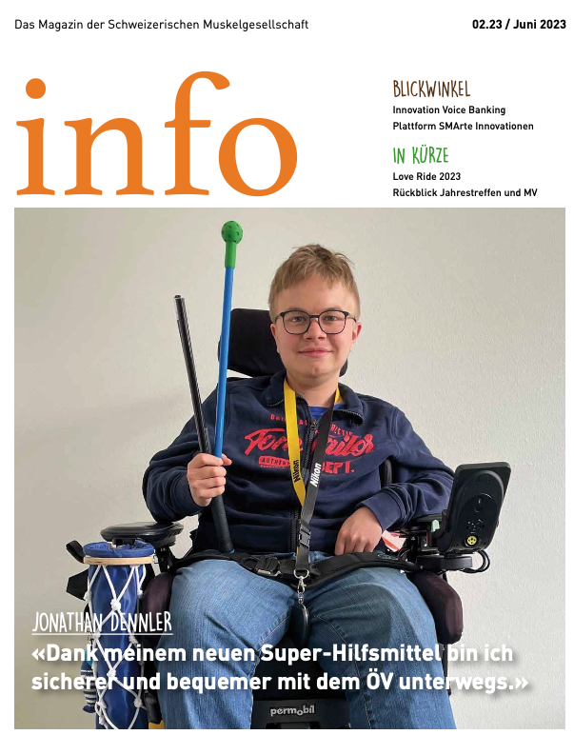
Digital Platform opportunities
+
“Thanks to my super aid, I am safer and more comfortable travelling by public transport”
Gruebner, et al 2024 International Journal of Public Health
Gruebner, et al 2023 DIGITAL HEALTH
Gruebner, et al 2022 Journal of Medical Internet Research
https://www.muskelgesellschaft.ch/wp-content/uploads/2023/06/info2.23_Web.pdf

Slide 3
Background
By 2050, nearly 70 percent of the global population will live in cities
Inclusive and accessible urban spaces become increasingly important, particularly for disability affected persons
Convention on the rights of people with disabilities, implementation varies greatly across countries
Digital transformation and smart city approaches provide emerging opportunities for urban health
→ However, the extent to which smart city applications consider or even fulfill the needs of individuals with disabilities remains underexplored

Slide 4
Research AIMS
Provide an overview about the existing literature on the interplay of smart cities and disability
Identify gaps and opportunities for future research and policy development

Slide 5
Definitions
Smart City
“urban area that uses electronic data collection sensors located in infrastructures, buildings, vehicles, institutions, and devices (IoT, Internet of Things) to supply real-time information of the main cities’ operating systems” Moura, F., & de Abreu e Silva, J. (2021)
Smart Citizen
“not only the beneficiary of the services provided by smart city but also a new type of member of the digital society that expects more interactive and responsive relationships with the local authorities and is ready and willingly to assume a bigger active engagement in defining, tailoring and updating online public services” Ianculescu, M., Bica, O., Balog, A., & Cristescu, I. (2019)

Slide 6
Methodology
Search Strategy:
Urban
AND smart OR "internet of things"
OR "social media" OR "digital platform"
AND disability OR handicap
OR functioning OR wheelchair OR accessible
AND
"2014/01/01"[Date - Publication] : "2024/12/31"[Date - Publication]
AND English[Language]
AND Humans[MeSH]
Scoping Review
Organized in covidence.org, N=8 reviewers, two reviewers screened
each item
Databases
PubMed, Scopus, Web of Science

Slide 7
Eligibility criteria
Include
Urban context
Motor disability
Digital platforms, Tech Aid
Outdoors
Physical accessibility
Peer reviewed original or review articles
in English language, published 2014-2024
Exclude
Non-urban context
Visual, hearing, cognitive, etc. disability
Algorithms, Models
Indoors
Digital accessibility

Slide 8
Prisma
N=2’977 studies imported for screening
N=31 duplicates identified
N=2’946 studies screened based on title and abstract
N=2’684 studies irrelevant
N=154 full text studies assessed for eligibility
N=106 studies excluded
N=48 Studies included

Slide 9
Preliminary results
N=48 Studies extracted
Majority from North America, Europe
Also: Bangladesh, Uganda, Palestine
Years: 2015-2024
Smart city applications, N=9
Smart citizen applications, N=23
Other, N=16
OG: Hey Chat GPT, please create a happy drawing sketch to visualize the topic of smart cities, disability, and accessibility

Slide 10
Word Cloud of Titles and Abstracts

Slide 11
Results and Discussion
Key themes identified in city planning, tourism, and university campus settings
Smart citizens
App-based assessments
Physical barriers
Wayfinding and inclusive navigation of public transit and public spaces
Parking spaces
Wheelchair mounted sensors and assistive devices (GPS, RFID, vibration detection, visuals)
Surface types, street features, inclinations of ramps, curbs, step heights
Visualizing wheelchair navigation to pedestrians
Robots
Smart cities
Monitoring urban accessibility (RFID, Bluetooth, and GPS acquisition)
Cooperative traffic assistance
Mobility and parking solutions for disability affected persons

Slide 12
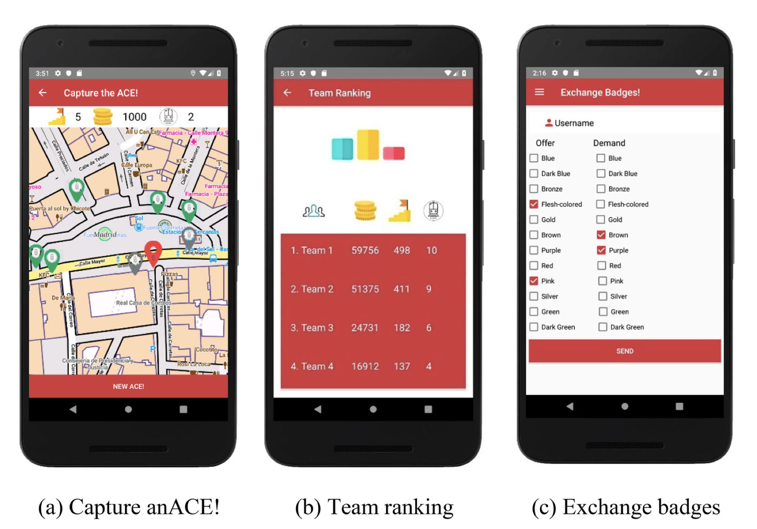
Smart Citizens
Participatory approach / gamification
Cáceres, P., Cuesta, C. E., Vela, B., Cavero, J. M., & Sierra, A. (2020). Smart data at play: improving accessibility in the urban transport system. BEHAVIOUR & INFORMATION TECHNOLOGY, 39(6), 681–694. https://doi.org/10.1080/0144929X.2019.1652852

Slide 13
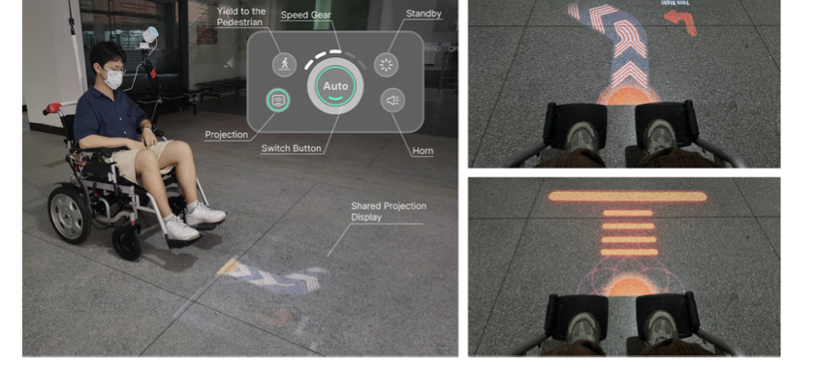
Technical Aids for Smart Citizens
Bridging Human–Machine Understanding in Wheelchair Navigation
Zhang, X., Song, Z., Huang, Q., Pan, Z., Li, W., Gong, R., & Zhao, B. (2024). Shared eHMI: Bridging Human–Machine Understanding in Autonomous Wheelchair Navigation. Applied Sciences (Switzerland), 14(1). https://doi.org/10.3390/app14010463

Slide 14
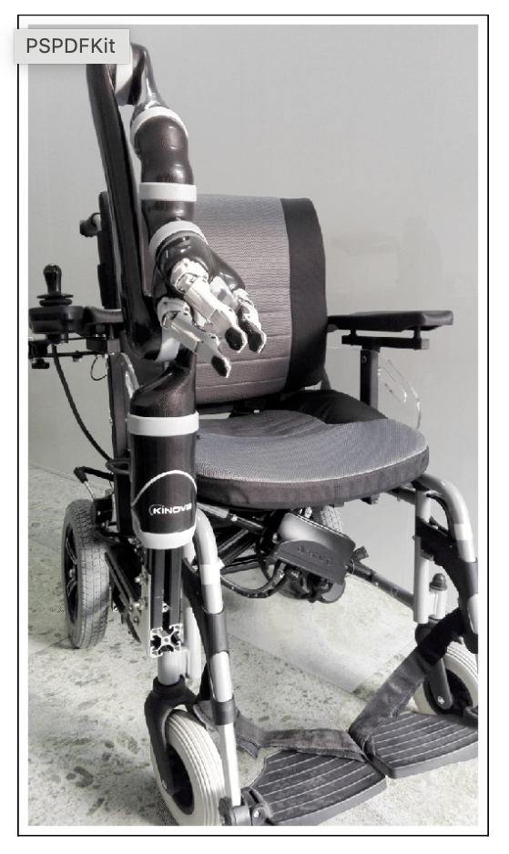
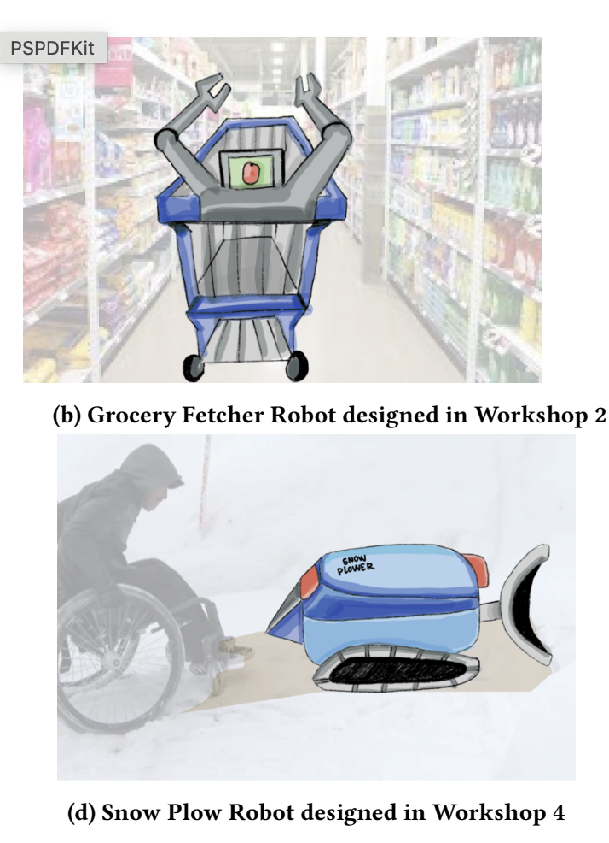
Technical Aids for Smart Citizens
Automated Wheelchair
Co designing accessible public robots
Han, H. Z., Li, F. M., Baca-Vazquez, A., Byrne, D., Martelaro, N., & Fox, S. E. (2024). Co-design Accessible Public Robots: Insights from People with Mobility Disability, Robotic Practitioners and Their Collaborations. Conference on Human Factors in Computing Systems - Proceedings.
Mishra, P., & Shrivastava, S. (2023). Automated Wheelchair for the Physically Challenged with AIoT Modules. In Edge-AI in Healthcare: Trends and Future Perspectives (pp. 97–114).

Slide 15
Smart City
Monitoring urban accessibility in smart cities with RFID/NFC/BLE and GPS acquisition
Mora, H., Gilart-Iglesias, V., Pérez-Del Hoyo, R., & Andújar-Montoya, M. D. (2017). A comprehensive system for monitoring urban accessibility in smart cities. Sensors (Switzerland), 17(8). https://doi.org/10.3390/s17081834
Yang, H. F., et. al (2022). Cooperative traffic signal assistance system for non-motorized users and disabilities empowered by computer vision and edge artificial intelligence. Transportation Research Part C: Emerging Technologies, 145.

Slide 16
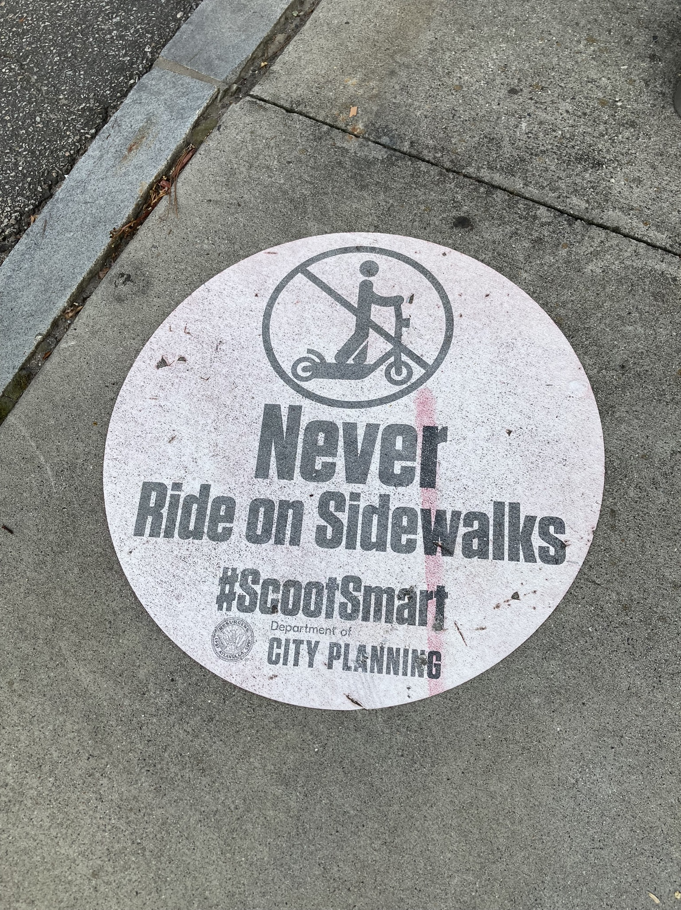
Strength and Limitations
Overview of current literature on the topic
Create awareness in terms of equity, scientific representation, and policy engagement in this context
Our literature review potentially missed some papers and local initiatives not published in scientific outlets
Focused primarily on high income countries
Photo: Author. Atlanta, Piedmont Ave NE / John Portman Blvd.

Slide 17
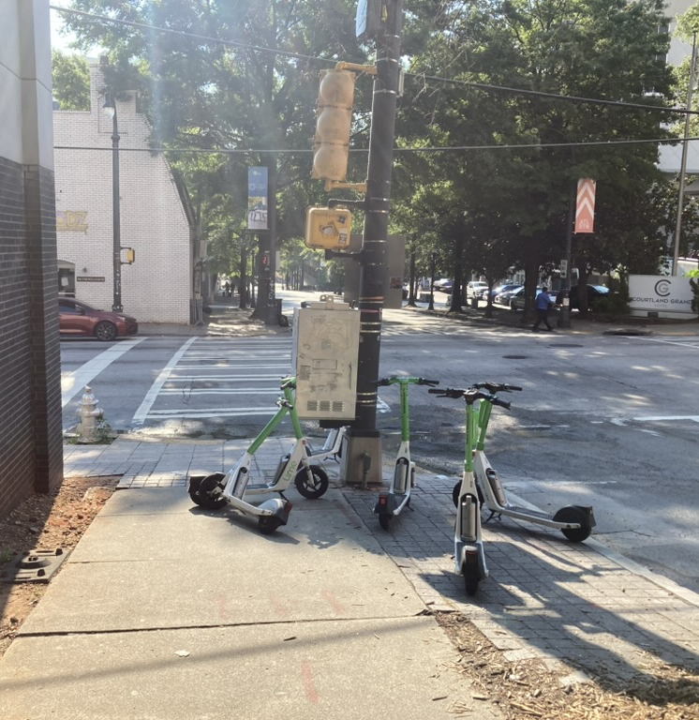
Conclusions
Authors’ advice to Atlanta Department of City Planning
Growing interest and need in smart city applications and their potential impact on disability inclusion
Crucial need for more inclusive and participatory approaches (of affected groups) and for policy engagement
Future research should
Include more low-income countries
bridge the gap between smart city strategies and the lived experiences of people with disabilities
promote equity, empowerment, and social justice within urban environments
#ParkSmart:
Never
block Sidewalks
Photo: Author. Atlanta, Andrew Young Int. Blvd.

Slide 18
Thank you!
Dr. sc. Nat. Oliver Gruebner
Lecturer and Senior Researcher
Health Sciences and Medicine
University of Lucerne
Group leader Digital Public Health
Public Health Schweiz
President Duchenne Schweiz

